Slide 1


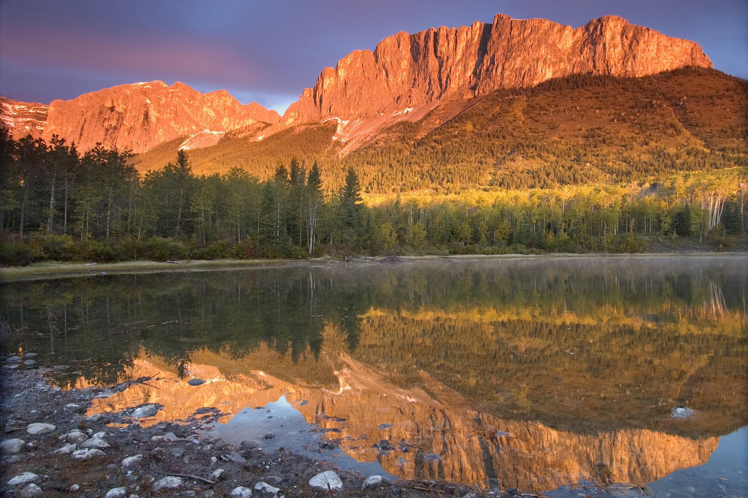

Programming CEC 2024
Team Yamnuska

Slide 2




Team
Raphaël Fontaine Year 3 Computer Engineering
David Breton Year 4 Computer Engineering
Émile Riberdy Year 4 Software Engineering
Sasha Nicolas Dolgopolyy Year 2 Software Engineering

Slide 3
Agenda
Data Structure
Algorithms
1
2
Visualization
Questions
3
4

Slide 4
1. Data Structure

Slide 5
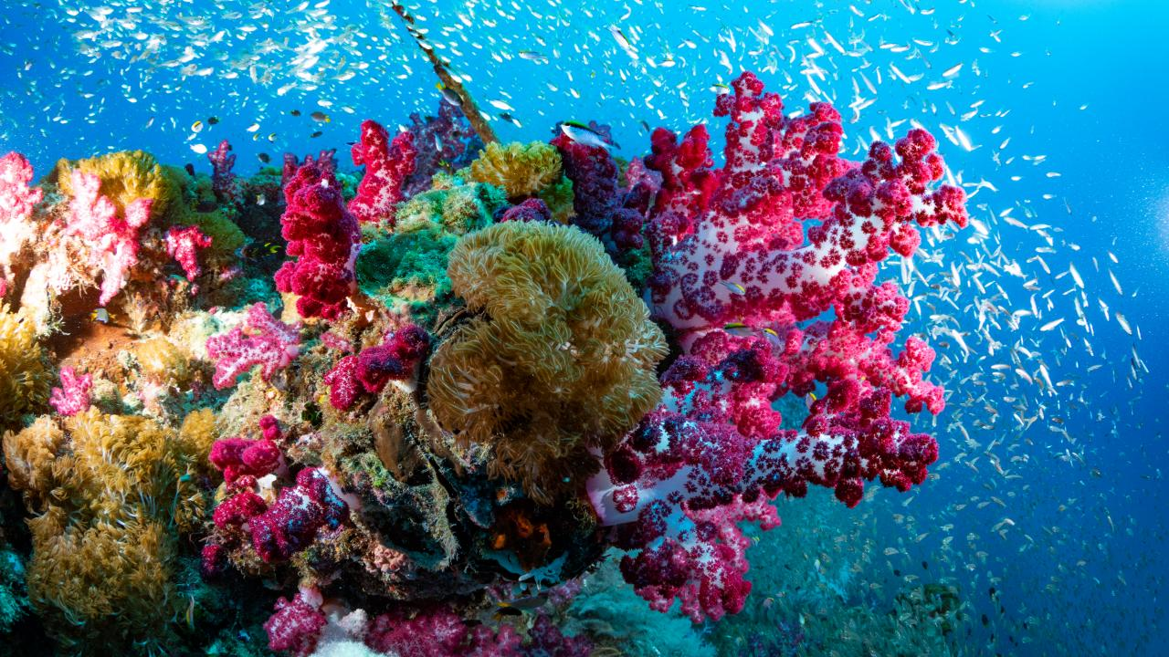
Chosen Datasets
4 obtainable datasets
Oil
Precious Metals
Helium
Shipwrecks
1 preservation dataset
Coral Reefs

Slide 6
Standardized Data
Search Space Structure (4D)
Shape(100,100,30,2)
{
Axis0 = x
Axis1 = y
Axis2 = day
Axis4 = (is_land, normalized_value)
}
Change Data Structure
CSV
Numpy array
Normalize Value Range
?..?
0..1
NaN values set to 0
4 Obtain sets
( 4
Normalize
Final navigable map
Preservation
value
)

Slide 7

Search space
Searchable 3D structure to find a path
Allows for pathfinding through time
Each cell contains the normalized score value at this location, on the specified day
Y
X
Days

Slide 8
2. Code

Slide 9
Code Structure
DataBuilder – Class:
Import data from csv
Converts data to data structures
Generates json used for visualization
Provides helper to find the possible moves given a position
GeneratePaths – Class
Computes path in the search space for both rigs
Generates json used for visualization
Path – Class
Helper class for a rig path

Slide 10
Code Structure
DataBuilder - Class
get_search_space (function)
next_possible_move_first_rig(function)
next_possible_move_second_rig(function)
generate_array (helper function)
generate_arrays (function)
get_possible_moves (helper function)
is_in_neigbourhood_of_first_rig (helper function)
get_search_value_at (helper function)
GeneratePaths – Class
generate_path_first_rig (function)
generate_path_second_rig (function)
next_move_rig (helper function)

Slide 11
Code Structure
Path – Data Structure Class
set_day_position()
get_day_value()
get_day_position()
get_total_value()
Creates our path data structure for use by our frontend

Slide 12
Algorithm Design: First Ideas
Genetic algorithm
Compute time
Coding time
Local search
Randomize sections in path
Difficult implementation of neighbors
Q-Learning
Map size
Implementation time

Slide 13
Algorithm Design: First Points
Focus on initial implementation
Greedy with 2 step lookahead
Slow lookahead
DataBuilder optimization
Eliminated loop in looking for available moves
Sped up the algorithm considerably

Slide 14
Greedy Algorithm
Greedy Assumption:
Using the best path for the next 4 steps allows for an optimal complete path
Algorithm:
Find best path for the next 4 steps
Step with the first move of this path
Iterate by computing the next 4 best steps from this new position
Important Points:
Scalable (search space dependant on number of steps)

Slide 15
Algorithm Design: Results
30 days and normalized value:
Max of 1.0 score for each day
A score of 1.0 means the maximum available resource were harvested, and no preservation targets were destroyed
Max total score of 30
Results on given dataset:
1st rig: 23.01
2nd rig: 20.22

Slide 16
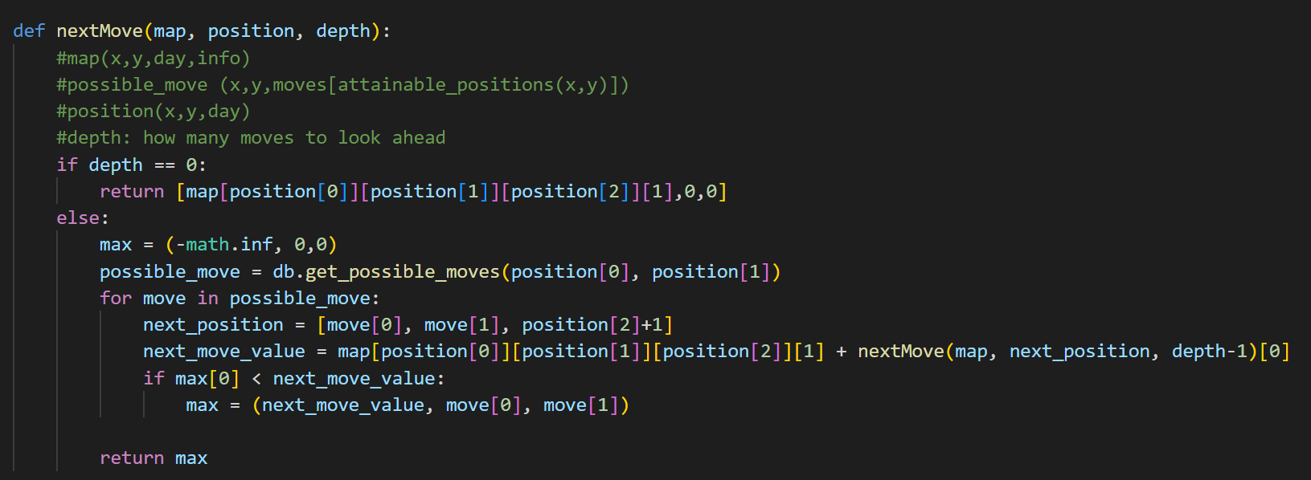
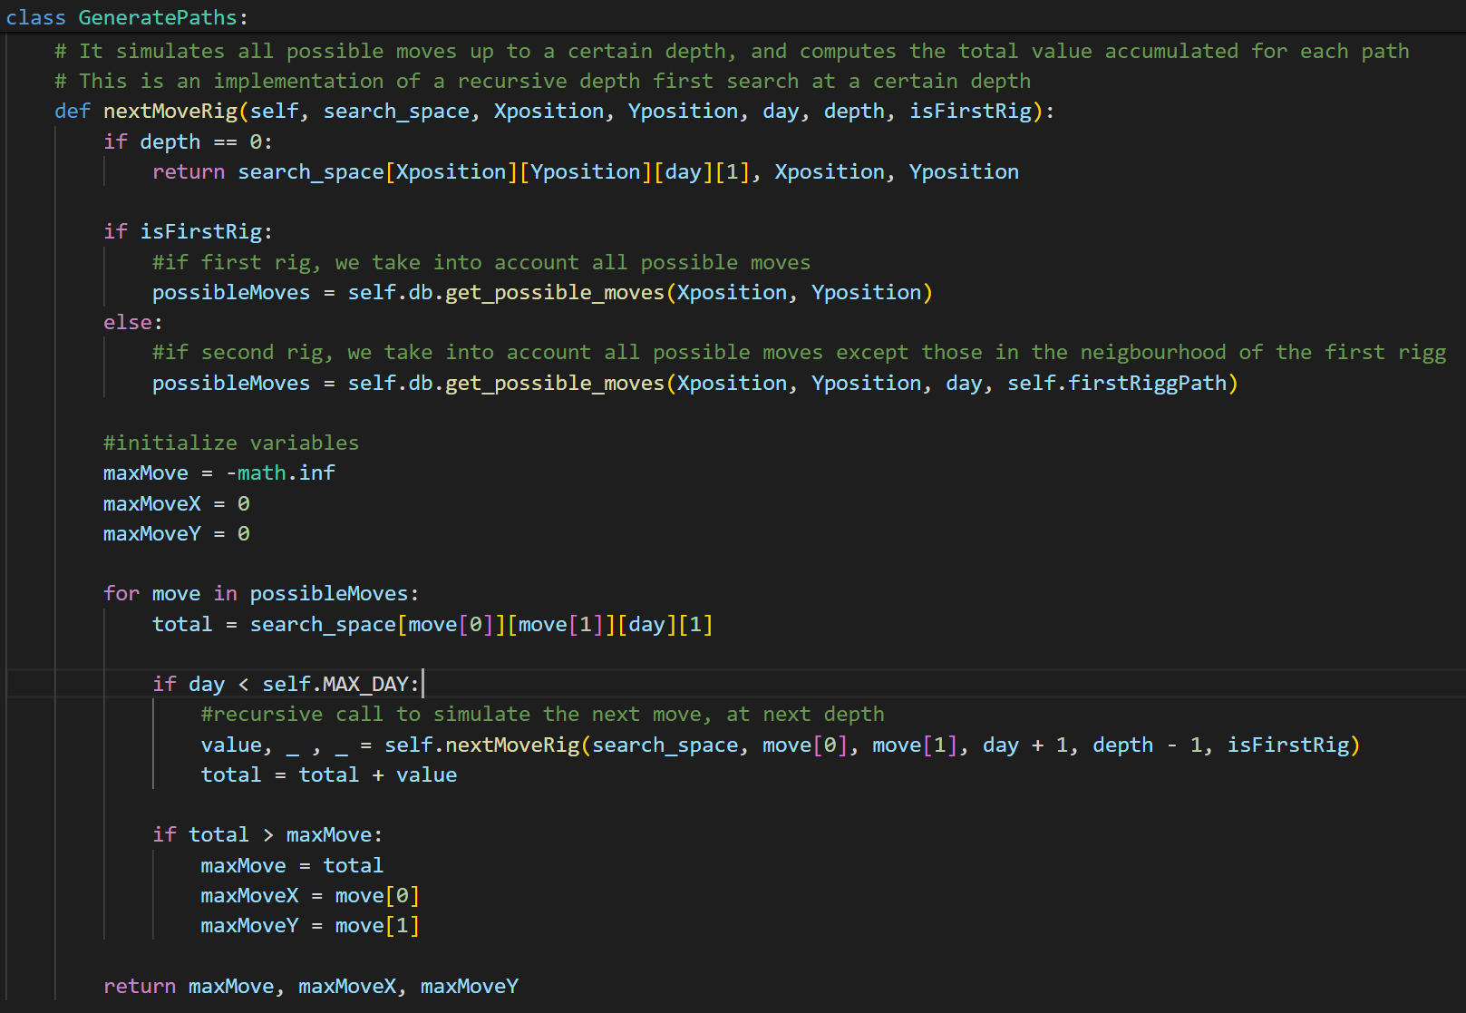
Iteration process
Coded and tested algorithm before implementing

Slide 17
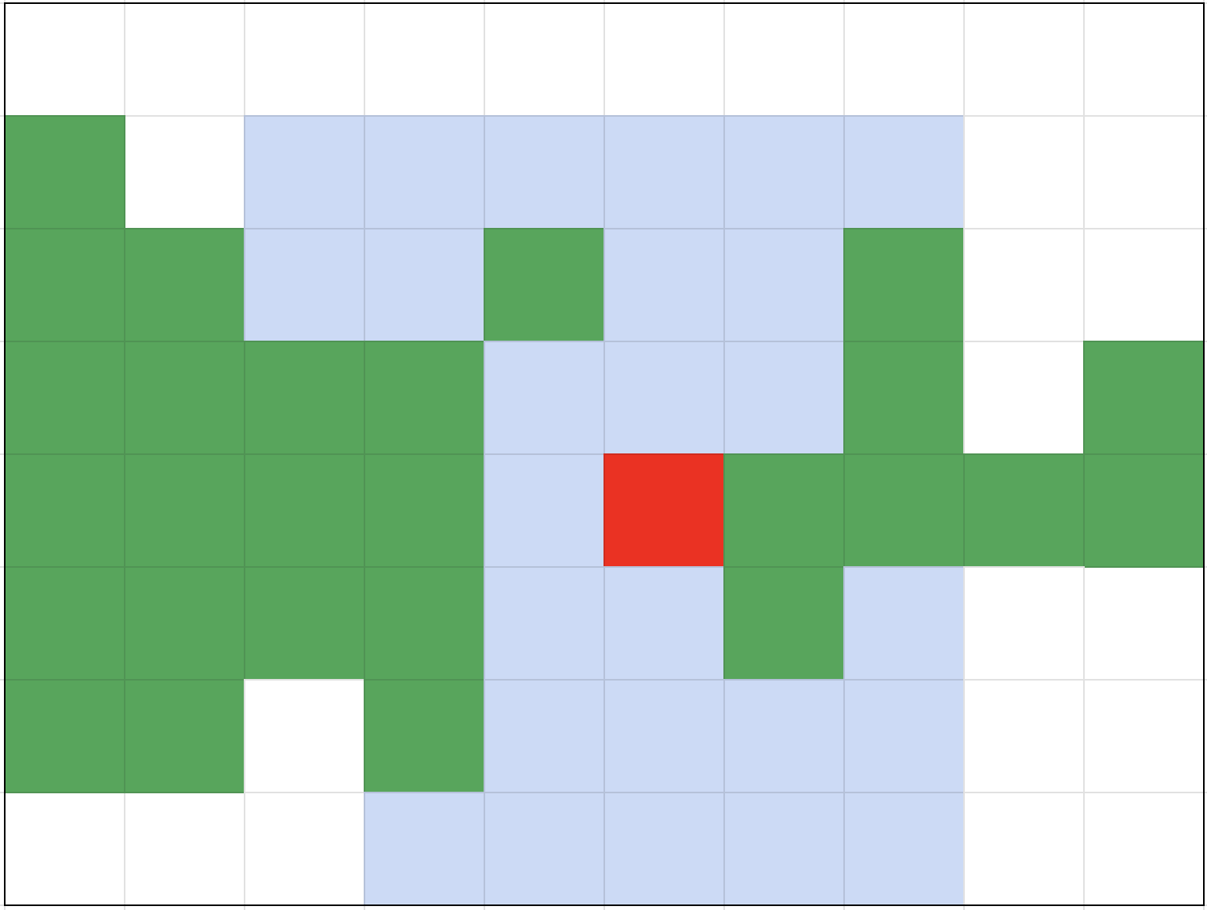
Possible Moves
Example of 3 Step Implementation
Init
Set Step number to 3
Visited array (position and step number)
Position Array (possible end positions)
Iteration
Add current position to arrays
Check if number of steps is not 0
Check if position with number of steps not in visited Array
Steps in all valid position and decrement number of steps

Slide 18
3. Visualization

Slide 19
Idea
Angular Web App
Interactive
Visualize part of the map

Slide 20
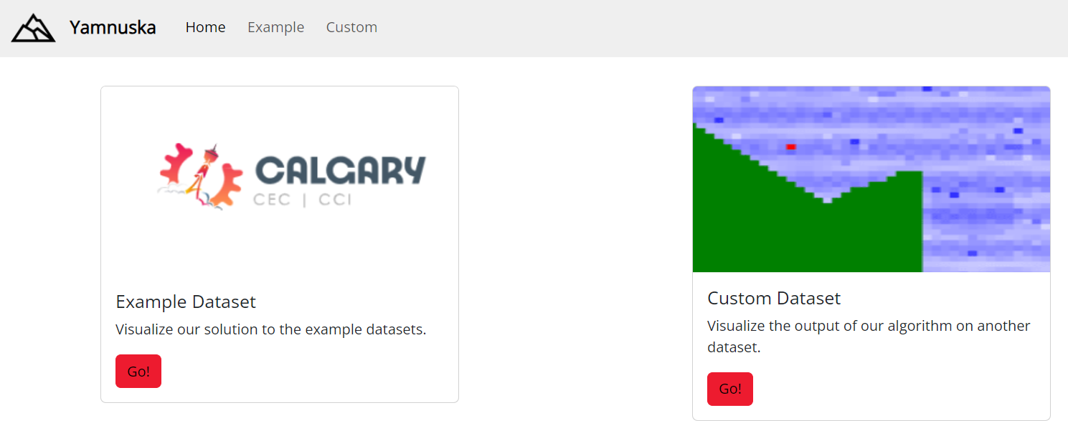
Main Functions
Visualize the output of the example datasets
Visualize the output on any datasets

Slide 21
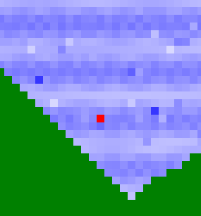
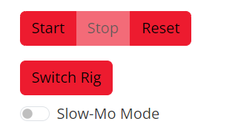
Interface Features
Visualize movements of the rigs on the grid
Visualize normalized score of each position
Track Rig #1 or Rig #2
Pause/Start/Reset
Slow-Mo mode

Slide 22
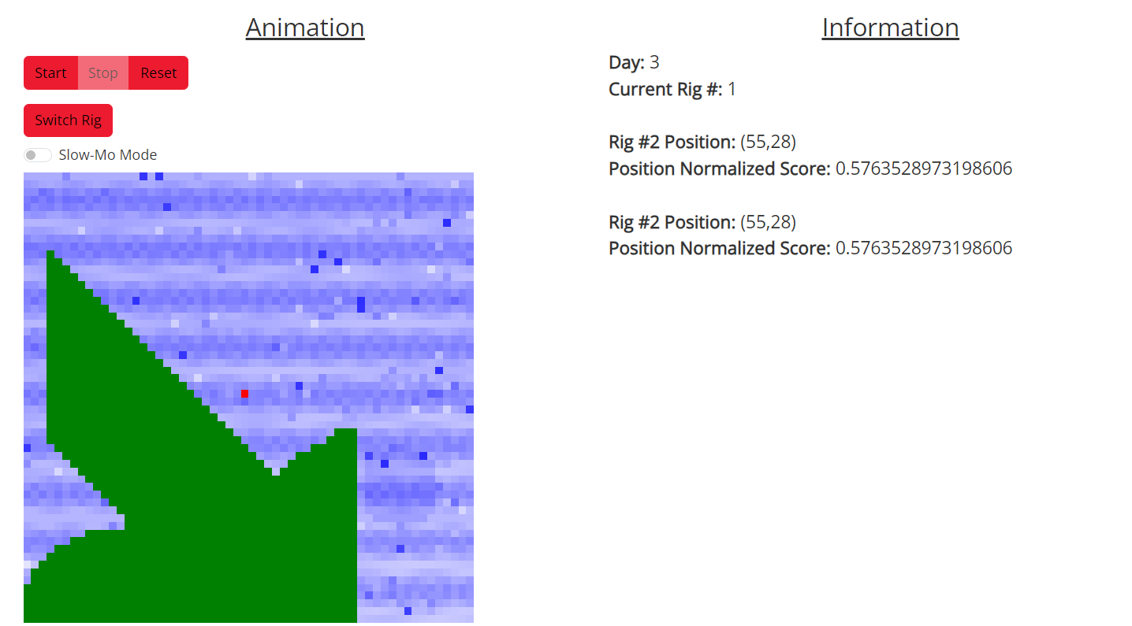
Example Page

Slide 23
Visualization
DEMO

Slide 24
4. Questions

